Slide 1
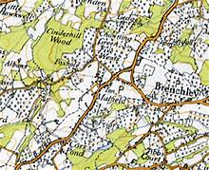
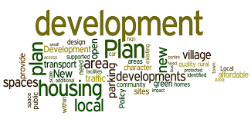
The new Tunbridge Wells Borough Local Plan and its implications for Brenchley and Matfield
Public meetings
Matfield - September 18 / Brenchley - September 23
Lindsay Frost –Independent planning consultant

Slide 2

What this presentation will cover
A. The purpose of the planning system
B. The plan-led system : local plans and neighbourhood plans
C. Plans in Tunbridge Wells Borough
D. The new Local Plan and its development strategy
E. Implications for Brenchley and Matfield
F. Issues for discussion
G. How to make your views known

Slide 3

A. The purposes of the planning system
Regulate the development and use of land in the public interest ( not to advance ,or harm, the interests of any individual or organisation)
Balance the need for development ( such as homes , jobs or infrastructure) with the need to protect and improve important features of the local environment
Deliver sustainable development : meeting social and economic needs , whilst
not compromising the legacy to future generations
Testing applicants’ schemes through the planning application process and giving a say to people affected by development schemes
Controlling unauthorised development
The system is plan-led : based on development
plans produced by locally-elected councils ,in
consultation with local communities , and subject
to independent examination

Slide 4
B. The plan-led system : local plans
The development plan for an area has two components : the local plan ( prepared by the local planning authority) and any neighbourhood plan prepared by a town/parish council or constituted neighbourhood forum
Each Local Planning Authority (LPA) must prepare a local plan for its area, looking ahead 15-20 years and based on a strong local evidence base which should set out :
what development is needed in the area
allocations of land to meet development needs
the infrastructure necessary to support development
key features of the built and natural environment to be preserved and enhanced
planning policies to guide decisions on planning applications ( decisions should normally be made in accordance with the development plan ) and secure development in line with the plan
Must be broadly in line with national planning policy
Meet the Government’s “tests of soundness”
Meet any European law obligations (e.g. Habitats Regulations)
Public involvement required by law and essential to production of an effective plan
Tested by Public Examination and independent inspector
Require Strategic Environmental Assessment (SEA) to demonstrate sustainable choices made

Slide 5
The plan-led system: neighbourhood plans
Since the Localism Act 2011 , town /parish councils have been able to prepare neighbourhood plans , so that plans are made by the people most affected by them
The neighbourhood plan can :
establish detailed planning policies for its area
identify sites for new development , but not less overall development than indicated in the local plan
identify key features of the built and natural environment to be preserved and enhanced
and thus strongly influence the outcome of planning applications in the area
But must :
be prepared within the framework set by national and local planning policy
Meet any European or national legal requirements ( such as Habitat Regulations)
show that it has engaged with the local community and taken account of their views
be tested by an independent examiner and endorsed by local referendum

Slide 6
c. Development plans in Tunbridge Wells Borough
There is a hierarchical system : each level sets context for level below.
National Planning Policy Framework (NPPF) (2019)
National Planning Practice Guidance (2014 and updates)
____________________________________________________________________________
Tunbridge Wells Borough Local Plan 2006 (saved policies only)
Tunbridge Wells Borough LDF Core Strategy (2010)
Tunbridge Wells Site Allocations Plan
Various TWBC Supplementary Planning Documents on detailed matters
New Tunbridge Wells Borough Local Plan (to 2036) draft published for consultation in September2019
Kent Minerals and Waste Plan (2016)
_____________________________________________________________________________
Neighbourhood plans prepared by town and parish councils, and neighbourhood forums ( 1 completed (Hawkhurst), and a further 8 underway in Tunbridge Wells Borough ,including Brenchley & Matfield )

Slide 7
D. The new Tunbridge Wells Borough Local Plan
Preparation of the plan has to comply with :
> the legal process set out in Planning Acts and Local Plan regulations
> national planning policy set out in National Planning Policy Framework ( February 2019) and associated practice guidance
Must meet “tests of soundness” in a public examination carried out by an independent Inspector appointed by Secretary of State ( see next slide)
Supported by a large bank of evidence : studies on current conditions affecting development and use of land , and how they are likely to change over next 15/20 years ( e.g. example : population and housing , economy and employment ,retail and town centres ,rural settlements ,built heritage ,landscape and ecology ,flood risk ,transport, green infrastructure )
Liaison and co-operation with KCC and adjacent local authorities ( Tonbridge & Malling, Ashford, Maidstone , Sevenoaks, Wealden,Rother) and with infrastructure providers and operators ( e.g. Network Rail, Highways Agency, Environment Agency)
Must be supported by a Sustainability Appraisal ( an assessment of strategy and policy options against social, economic and environmental objectives for the borough)

Slide 8
The Local Plan “tests of soundness”
All Local Plans in England must meet these tests:
Be positively prepared – providing a strategy which, as a minimum, seeks to meet the area’s objectively assessed development needs and is informed by agreements with other authorities, so that unmet need from neighbouring areas is accommodated - where it is practical to do so - and is consistent with achieving sustainable development;
Justified – an appropriate strategy, taking into account the reasonable alternatives, and based on proportionate evidence;
Effective – deliverable over the plan period, and based on effective joint working on cross-boundary strategic matters that have been dealt with rather than deferred, as evidenced by the statement of common ground;
Consistent with national policy – enabling the delivery of sustainable development in accordance with the policies in the NPPF

Slide 9
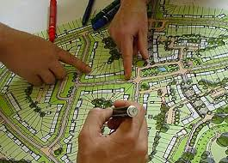
What does the Local Plan contain ?
The Vision and Objectives for the Borough ( what sort of place do we want to be by 2036 and how will we get there)
The proposed Development Strategy: how much, and where, development needs will be met;
Place shaping policies, including proposed site allocations for each parish/settlement within the borough;
Detailed development management policies ;guide development over the plan period and set a framework for the consideration of planning applications.

Slide 10
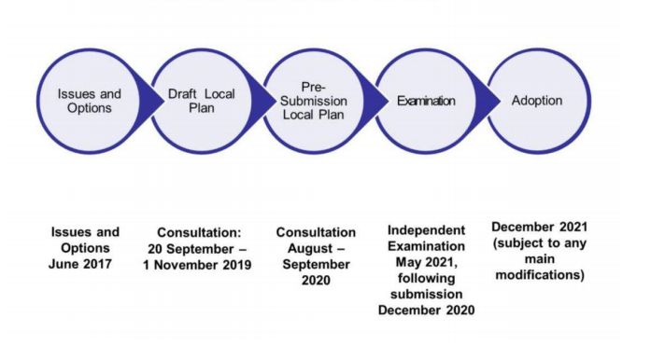
The Local Plan process

Slide 11
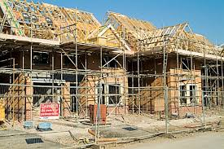
Key planning issues facing Tunbridge Wells Borough
Biggest planning issue facing TWBC is accommodating housing growth in a sustainable way , given the strong pressure for development , and the many environmental and infrastructure constraints, in the area
Past and future housebuilding rates –average annual completions
* Net actual average annual completions ** Implied future build rate in new Local Plan : this may change again as process evolves further
Period | TWBC
2001-2006 * | 313
2006-2011 * | 372
2011- 2016 * | 257
2016- 2030 ** | 678

Slide 12
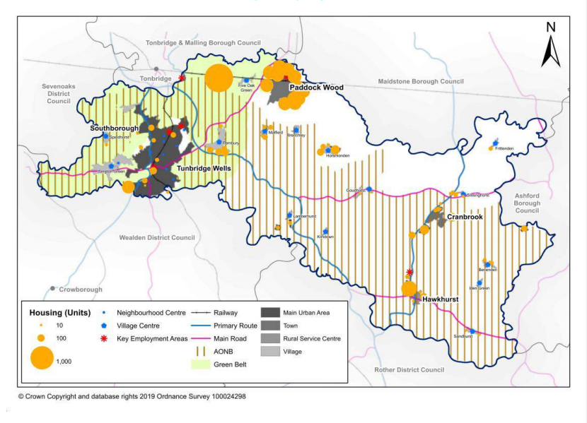
The local plan development strategy

Slide 13
Proposals for Brenchley and Matfield parish
91-150 new dwellings on four housing development allocation sites:
BM1: Land between Brenchley Rd, Copper Lane, Maidstone Road (30-45)
BM2: Matfield House orchards (20-30)
BM3: Ashes Plantation, Maidstone Road (30-60)
BM4: Land at Maidstone Road(11-15)
… plus any “windfall sites”, mostly within existing villages, which will have defined “limits to built development”
Protect High Weald AONB and other important landscape and natural features
Protect existing conservation areas and listed buildings
Developer contributions to upgrade local infrastructure in line with growth

Slide 14
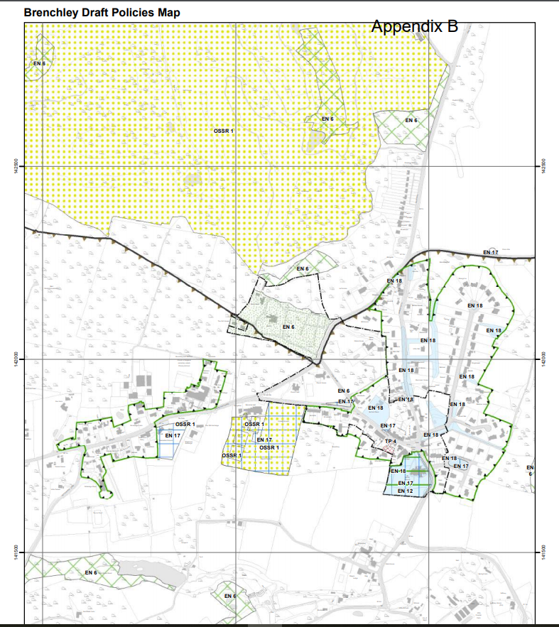
Brenchley Draft Policies Map

Slide 15
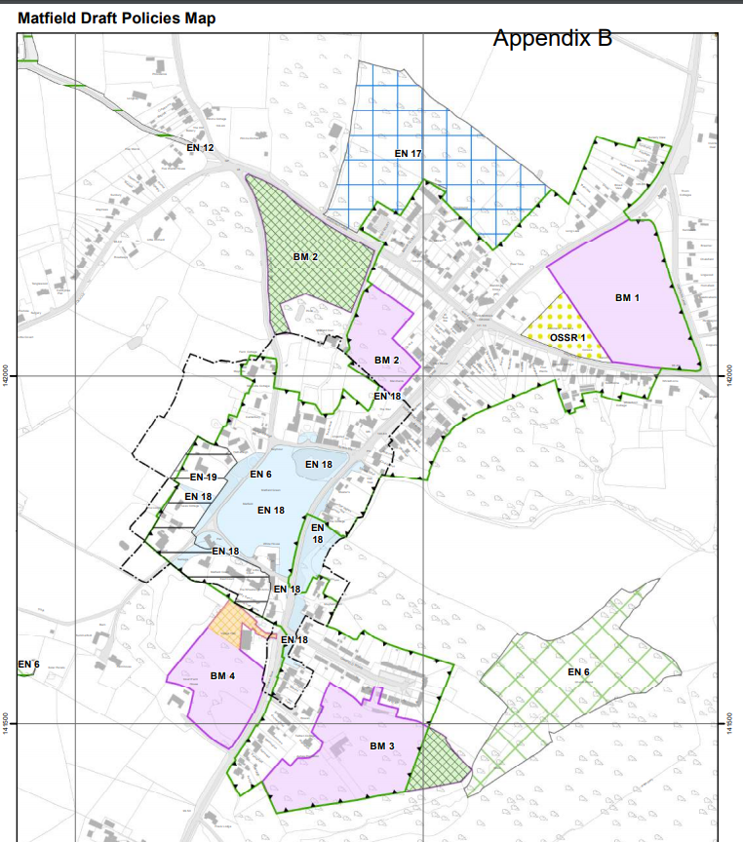
Matfield Draft Policies Map

Slide 16
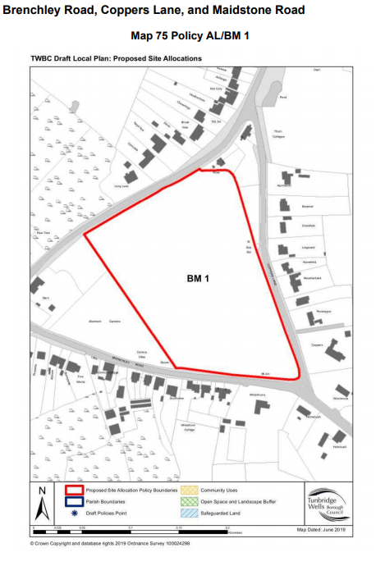
BM1: Land between Brenchley Road, Coppers Lane, Maidstone Road (30-45 dwellings)
Landscape /visual and heritage appraisals to inform site access and layout
Site access off either Maidstone road or Brenchley Road ( not Copper Lane)
Pedestrian access to link to local footways
On-site green spaces, allotments and playground

Slide 17
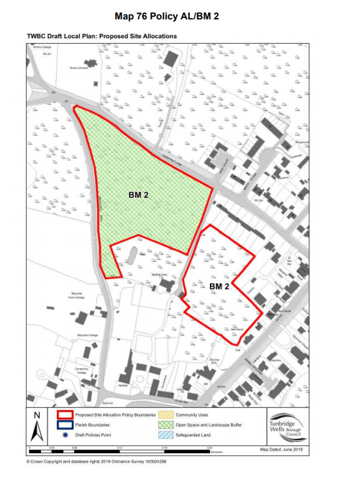
BM2 Matfield House orchards (20-30 dwelings)
Two parcels of land
Landscape /visual and heritage appraisals to inform site access and layout and protect built heritage
Site access off Chestnut Lane
Pedestrian access to link to local footways
Orchard land to be safeguarded and managed for its contribution to landscape and ecology
on-site amenity/natural green space, and improvements to existing allotments, parks and recreation grounds, children’s play space and youth play space

Slide 18
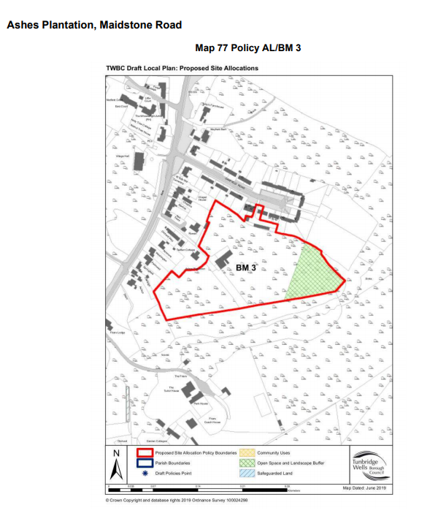
BM3: Ashes Plantation, Maidstone Road
(30-60 dwellings)
Vehicular access to be determined by highways assessment
Pedestrian access to link to local footways
Provision of on-site amenity/natural green space and children’s play space and improvements to existing allotments, parks and recreation grounds and youth play space
Reinforce southern landscape boundary
Compensation for any loss of parking in Oakfield road

Slide 19
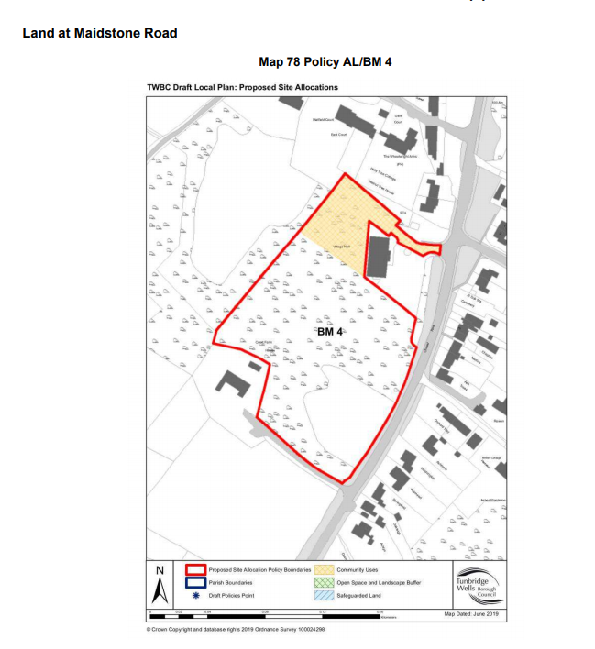
BM4: Land at Maidstone Road (11 -15 dwellings)
Need to retain existing trees and hedgerows on the site will require low density development
Access off Maidstone Road
Landscape /visual and heritage appraisals to inform site access and layout and protect built heritage
Improvements to existing allotments, amenity/natural green space, parks and recreation grounds, children’s play space and youth play space
Part of site retained for community use , including additional village hall parking

Slide 20
Infrastructure upgrades to support growth
The draft Local Plan suggests that the following local infrastructure may need to be upgraded to support growth:
Primary and secondary education
Health and medical facilities
The provision of buildings and spaces to provide cultural infrastructure;
The provision of allotments, amenity/natural green space, parks and recreation grounds, children’s play space and youth play space
A new sports hub at Paddock Wood, which could include open space and children's play space
The provision of information boards (or similar) and installation of public art along the Hop Pickers Line. Other locally significant historical features, events, and personalities could be recognised as part of this approach
Other mitigation measures identified through the pre-application process and planning applications
Play spaces and delivery of new children's playground at Matfield
Provision of improvements to broadband connectivity
Delivery of traffic calming measures at Matfield
Specific proposals are included with each of the housing development allocations

Slide 21

Implications for the Brenchley and Matfield Neighbourhood Plan
Need to review draft Local Plan to assess:
The overall development strategy and its impact on Brenchley and Matfield
Effect of the proposed development allocations at Matfield ( support , oppose or suggest modifications ?)
How the proposed district-wide policies apply locally : do they overlap with ,or constrain, any emerging B&MNP policies ?
Need for further discussions with
TWBC planning officers?

Slide 22
Where to find out more and make your views known
The draft local Plan is online at : https://beta.tunbridgewells.gov.uk/local-plan/local-plan-updates/lp-updates-items/august-2019-update-2
( a dedicated public consultation web page with all the local plan documents will go live later in September)
“LOCAL” : autumn edition of TWBC magazine which goes to all residents from 16 September onwards
Print media and social media
Stakeholder meetings
Exhibitions around the borough from 21 September to 4 October ( nearest are Horsmonden –Tues 1 and Paddock Wood Thurs 3 October)

